Slide 1
English Basics
A Review of Lessons 1 through 7

Slide 2
nouns
Person, Place, Thing or Idea

Slide 3
What is a noun?
Noun – a person, place, thing or idea
Common Noun – any noun that represents one or all of the members of a class
Examples: dog, cat, man, woman, education
Proper Noun – a noun that is the name of a specific person, place or thing
Examples: Susan, Charlie, Orlando, Walmart, Coca Cola

Slide 4
What is a pronoun?
Pronouns – a word that can take the place of a noun
Example: Marie works at David’s school.
She works at his school.
Personal Subject Pronouns – I, you, he, she, it, we, they
Personal Object Pronouns – me, you, him, her, it, us, them
Possessive Pronouns – mine, yours, his, hers, its, ours, theirs
Demonstrative Pronouns – this, that, these, those

Slide 5
What is a pronoun?
Interrogative Pronouns: who, whom, what, which, whose
Relative Pronouns: who, that, which, whom
Indefinite Pronouns: anybody, somebody, nobody, someone, something, no one, none, each
Reflexive Pronouns: myself, yourself, himself, herself, itself, ourselves, yourselves, themselves
Reciprocal Pronouns – used to identify and action or feeling that is reciprocated: each other, one another

Slide 6
verbs
Action Words

Slide 7
What is a Verb?
Verb – is a word which describes the action in a sentence
Present Tense – describes an action that is happening now
Examples: flies, sings, cries, sleeps
Past Tense – actions which happened some time ago
Examples: wanted, played, tried, kissed
Future Tense – actions which are going to happen
Examples: will awaken, going to start, will enjoy

Slide 8
Verb Tenses
Verb tenses describe WHEN the action is happening.
PRESENT (it’s happening NOW.)
PAST (it’s ALREADY happened.)
FUTURE (it’s ABOUT to happen.)
To change a verb from present to past most words add - ed
Present Tense
walk
jump
look
play
Past Tense
walked
jumped
looked
played

Slide 9
Verb tenses
Review

Slide 10
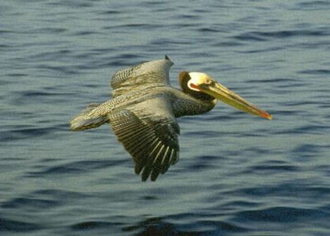
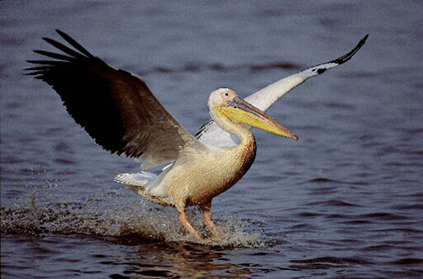
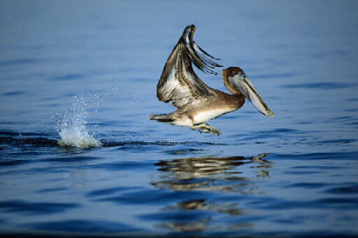
The importance of time
Verb tense expresses the time of an event or action.
Time and how it is expressed in writing is very important to English readers.
The English language has twelve different tenses.
flies
flew
will fly

Slide 11
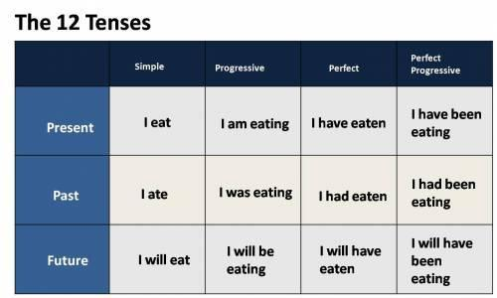
The 12 Verb Tenses

Slide 12
That's not a noun?
Learning verbs that are nouns
Nouns with different meaning in plural form
Introduction to Adjectives

Slide 13
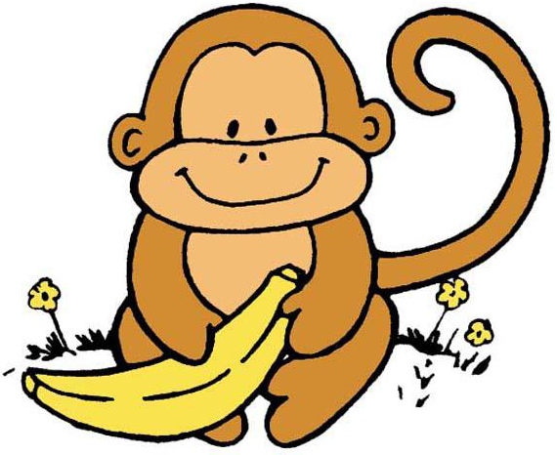
A word can be both a noun and a verb
There are many words that can be used to name a person, place or thing and also describe an action.
For example: Monkeys love bananas.
love – is a verb in this sentence,
but love is also a noun.

Slide 14
nouns?
There are many, many more examples of words that can be both nouns and verbs.
Here are a few that you will probably become familiar with:
act | back | cake | number
balloon | address | bank | drive
cook | flower | answer | face
drink | color | deal | bear
email | help | guide | jump

Slide 15
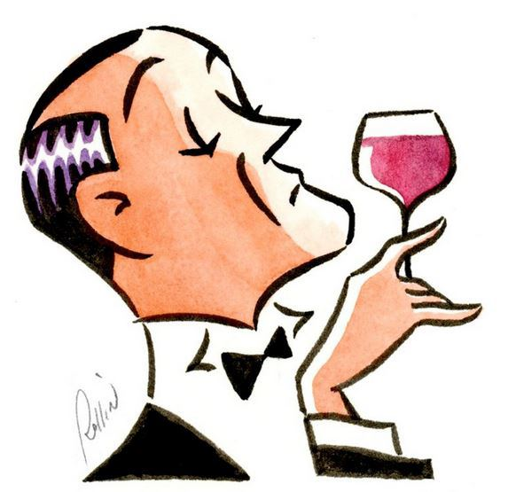
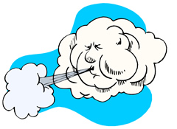
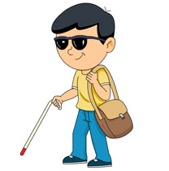
Nouns with different meanings in plural form
Some nouns have different meanings in the singular and the plural. Examples are given below:
air | atmosphere
airs | affected manners
blind | unable to see
blinds | protective covering to keep out light and for privacy

Slide 16
adjectives
Adjectives are words use to describe or modify a noun.
Adjectives never change.
They are never plural.
Adjectives go before their nouns.
Example:
This is a nice monkey.
The monkey loves fresh bananas.

Slide 17
Noun or verb or adjective?
Some words can be all three!
For example the word yellow:
The monkey ate a big yellow banana. Adjective
The banana has hues of yellow. Noun
The banana was green at first, but now it’s
beginning to yellow. Verb

Slide 18
That's not a Verb?
Learning nouns that are actually verbs
Introduction to Adverbs
The difference between Adjectives and Adverbs

Slide 19
verbs?
There are many, many more examples of words that can be both nouns and verbs.
Here are a few that you will probably become familiar with:
father | picture | cake | number
balloon | address | bank | beach
cook | flower | hand | face
radio | coin | deal | bear
sand | help | Pen | dog

Slide 20
Converting nouns or adjectives to verbs
You can change nouns and adjectives into verbs by adding the suffixes – ate, - ise, - en, - ify, - ing and - ed.
Here are some examples:
author becomes authorize
assassin becomes assassinate
dark becomes darken
class becomes classify
friend becomes friending
floor becomes floored

Slide 21
ADVERBS
Adverbs describe and modify or change other words, just as adjectives do.
HOWEVER, instead of describing things, they describe actions & qualities.
Adverbs qualify the meanings of verbs, adjectives, and other adverbs.
Adverbs answers these questions:
How did the runner run?
How deep was the snow?
How well did the singer sing?

Slide 22
Features of Adverbs
Many adverbs end in –ly: lovely, ugly, sadly, happily, briefly, easily, truly
Adverbs modify or change the meaning of a verb, an adjective, or another adverb
Modify Verb: Good drivers turn the corner slowly.
Modify Adjective: Really bad drivers turn that corner fast.
Modify Adverb: The car turned the corner really quickly.
Placement of adverbs can usually be moved around in a sentence without changing the meaning.
Adverbs that modify adjectives or other adverbs belong right in the front of the words they modify.

Slide 23
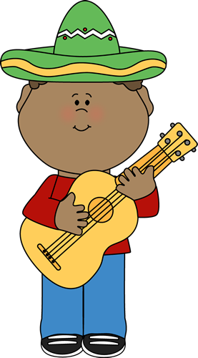
Adverb Examples
He played guitar skillfully.
He played guitar dreadfully.
He played guitar passionately.
He plays the guitar well.
He plucks the guitar string softly.

Slide 24
Adverbs vs adjectives
Adverbs describes verbs, adjectives and adverbs.
He left the room quickly.
She dances well.
He works hardly.
Adjectives describes nouns.
This is a nice room.
She is a good dancer.
He is a hard worker.

